Slide 1

Introduction to Python
Learn to Code 2018

Slide 2
github.com/oxcompsoc/learntocode
Notes:
All the resources are available on GitHub
Some of the resources are still based on last year’s course but they will be updated as we go along this year

Slide 3


Slide 4
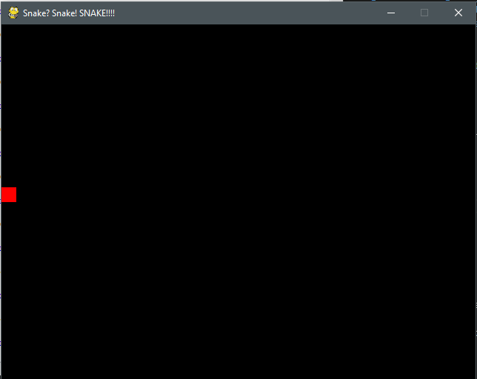

Slide 5
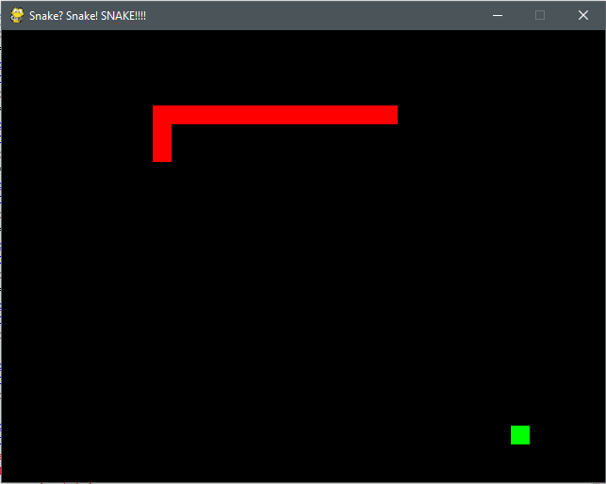

Slide 6
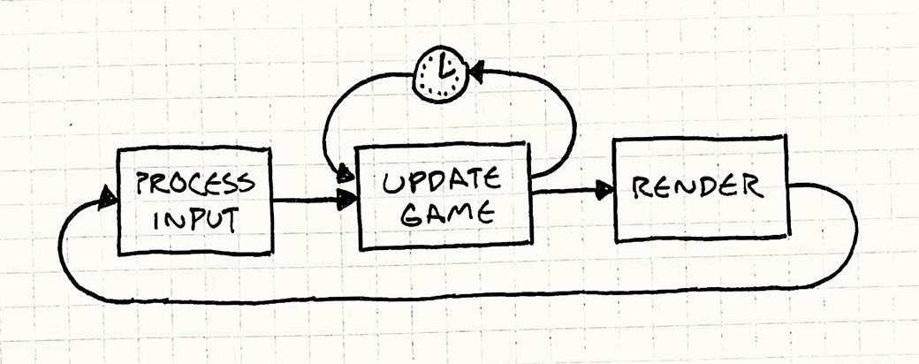

Slide 7
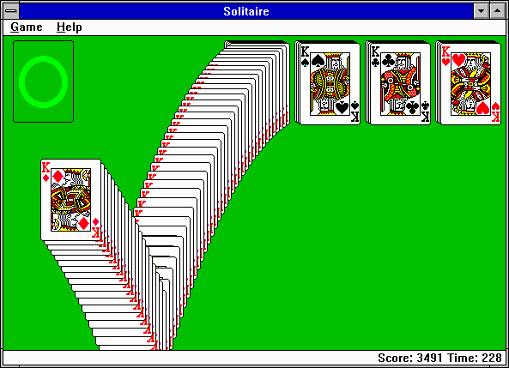

Slide 8
github.com/oxcompsoc/learntocode
Notes:
All the resources are available on GitHub
Some of the resources are still based on last year’s course but they will be updated as we go along this year

Slide 9

python.org

Slide 10


Slide 11
projecteuler.net

Slide 12
numpy.org
scipy.org

Slide 14
opencv.org

Slide 17
Thank You!

